Slide 1

QER11749
QER : JULIMAR DEVELOPMENT PHASE 3 SF301229C002.03 - Zeta wire damaged

Slide 2
Pipe section / Details
Item | Traceability / identification
Project number | 301229C002
Project name | JULIMAR DEVELOPMENT PHASE 3
Pipe section | SF301229C002.03
ST number | ST203.72124
Affected layer / equipment | Zeta Pressure Vault
Length affected | 768.2m
Drawing number / MP code / STA / Dimension | ZETA wire 6.2 FI09 (MP205)

Slide 3
Overview of anomaly
Problem Description :-
During the zeta spiraling of JULIMAR DEVELOPMENT PHASE 3 SF301229C002.03 (ST203.72124), zeta wire damage was detected after accumulator at length 768.2m.
Root Cause :-
The root cause was identified due to zeta wire offset/dislocated from roller accumulator and lead the wire damaged. The wire was dislocated due to gap for adjustment roller is too big (Original Design).
CA:
Fabricate new design for accumulator adjustment shaft.
Problem Handling:-
Production performed un-spiralling, removed affected wires and re-weld before proceeding spiralling process. Dimension after repaired are all within criteria and accepted as per DP-QCP-08DAQT001.

Slide 4
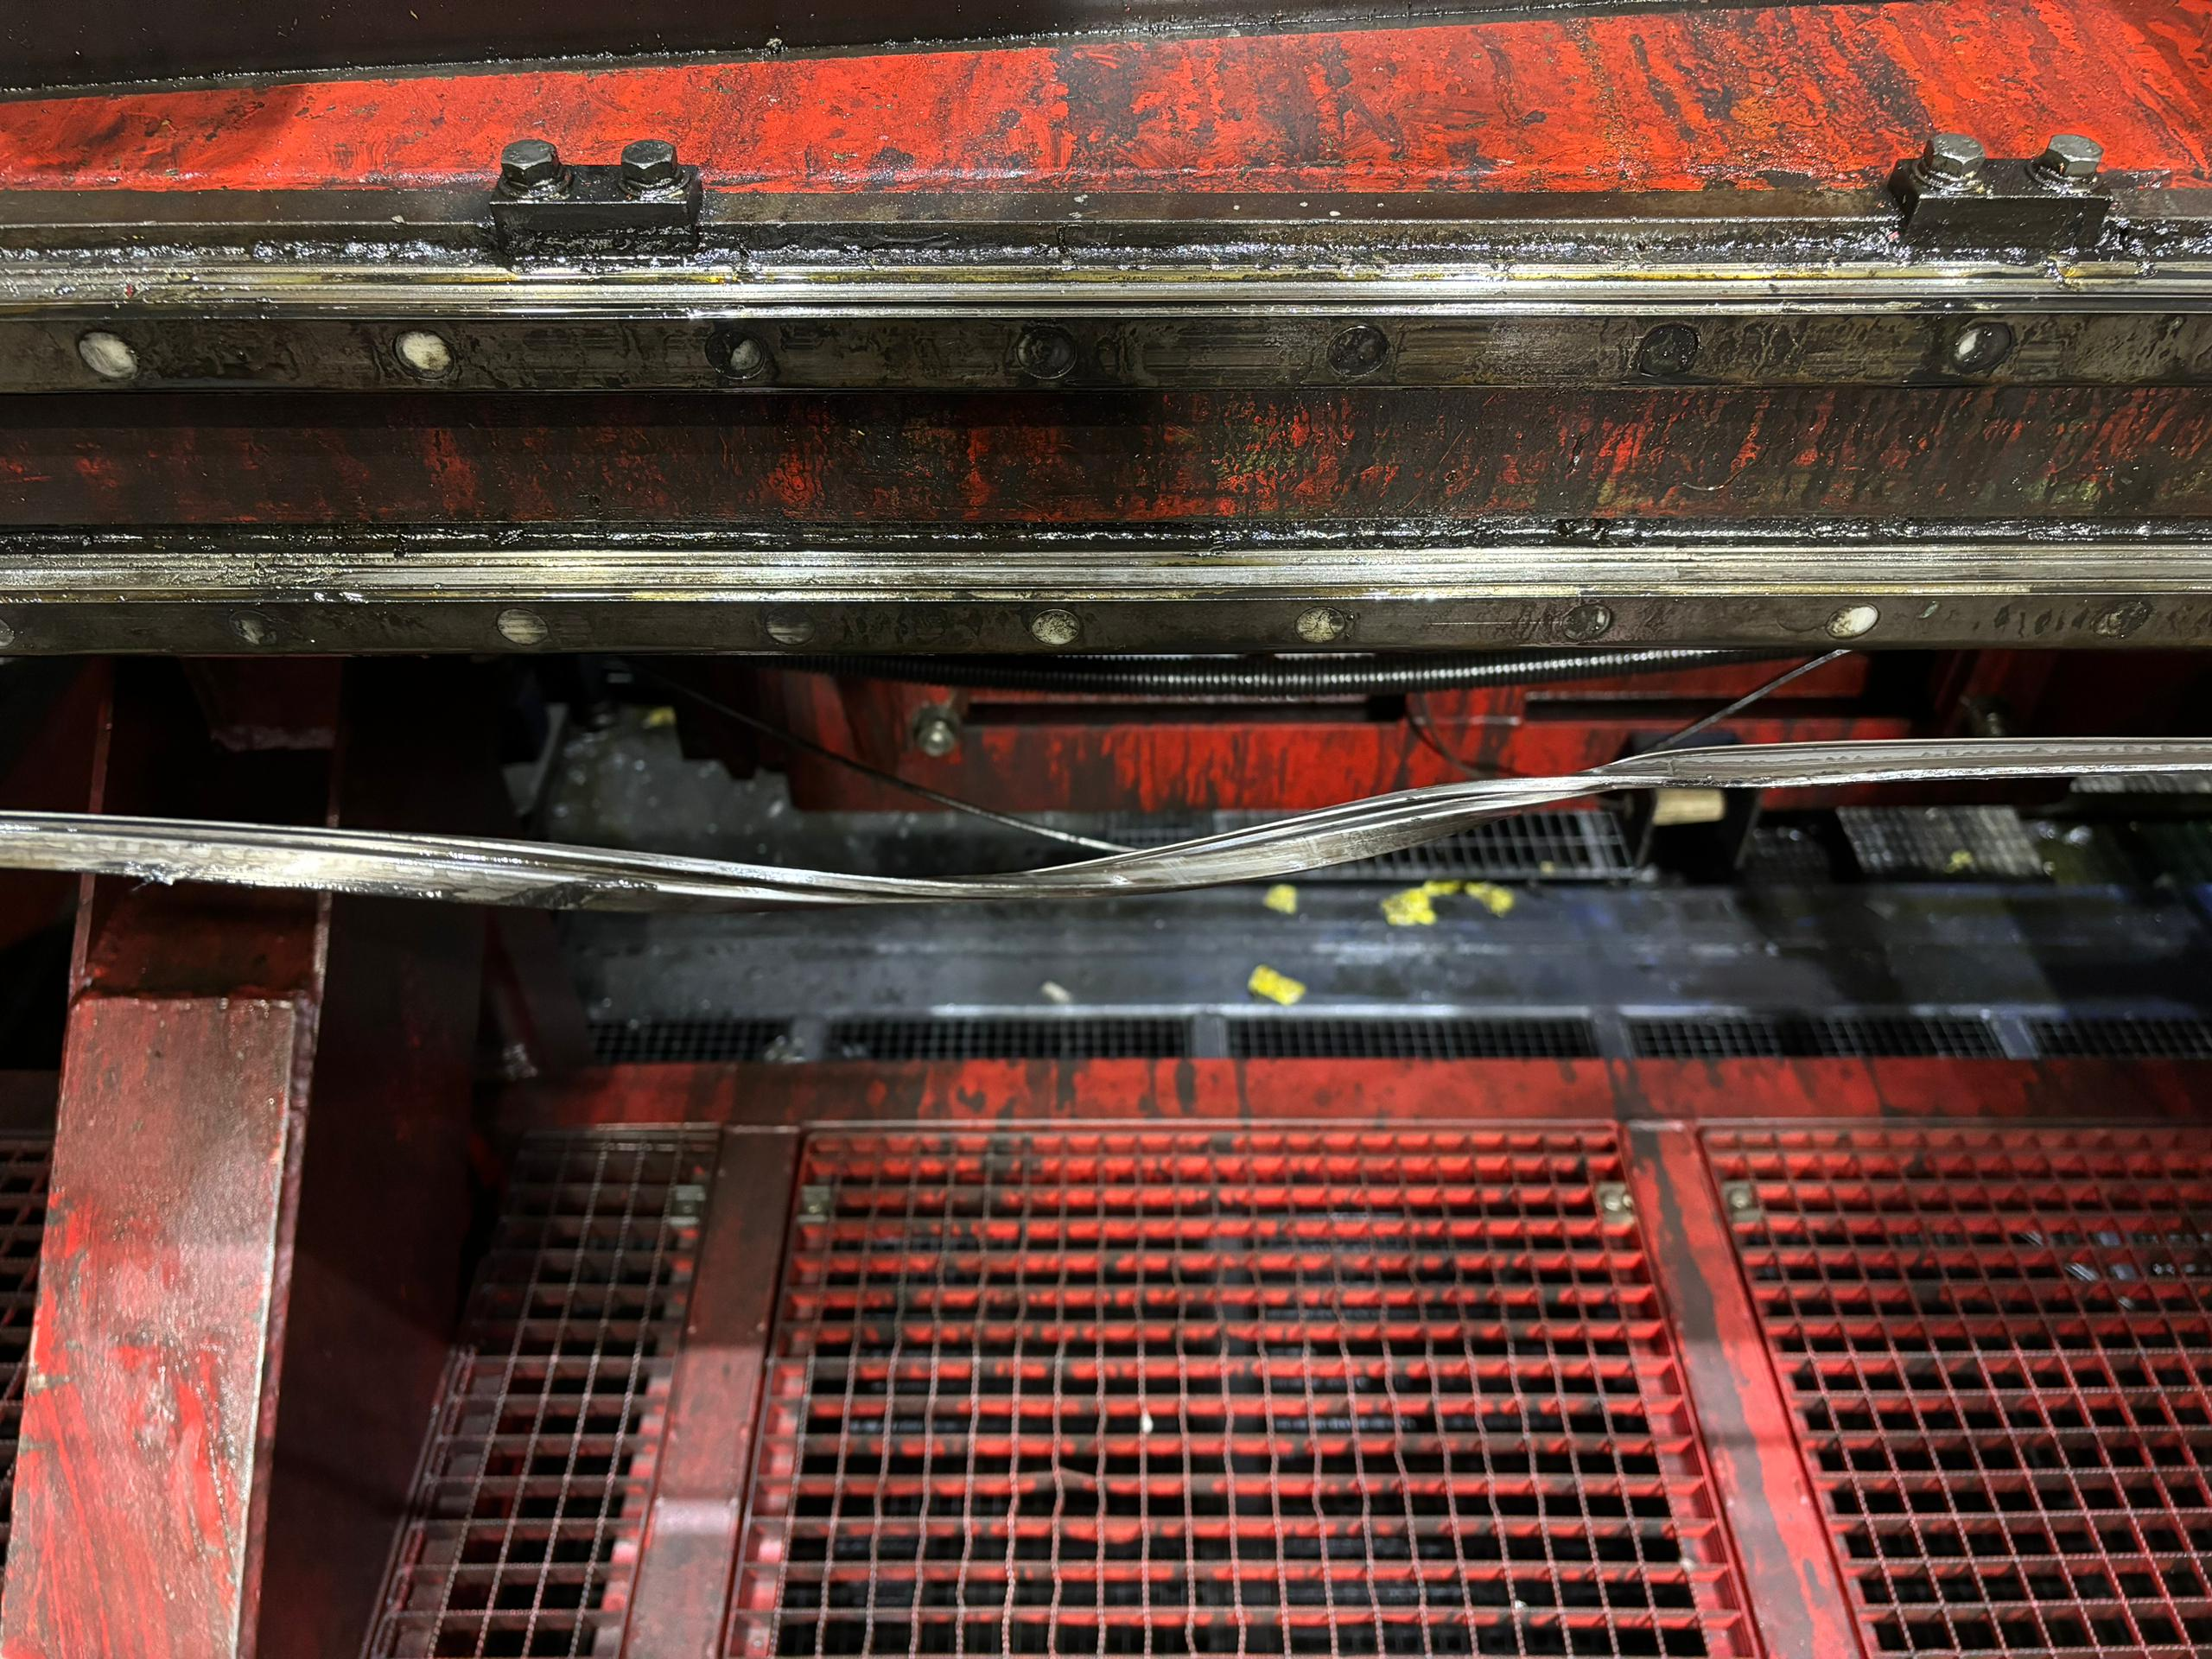
Defect Photos
Figure 1 : Zeta wire damage was detected after accumulator at length 768.2m.

Slide 5
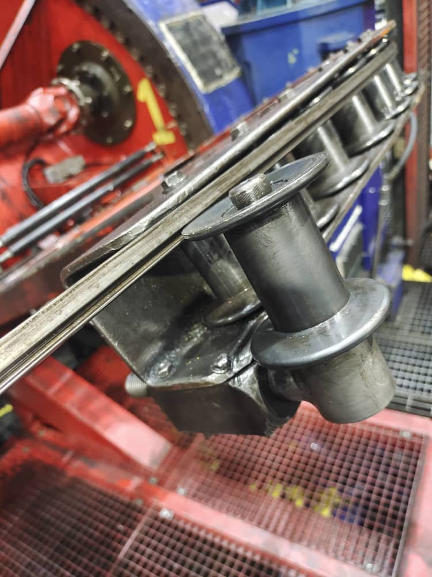
Root Cause
Figure 2 : The root cause was identified due to zeta wire offset/dislocated from roller accumulator and lead the wire damaged.

Slide 6
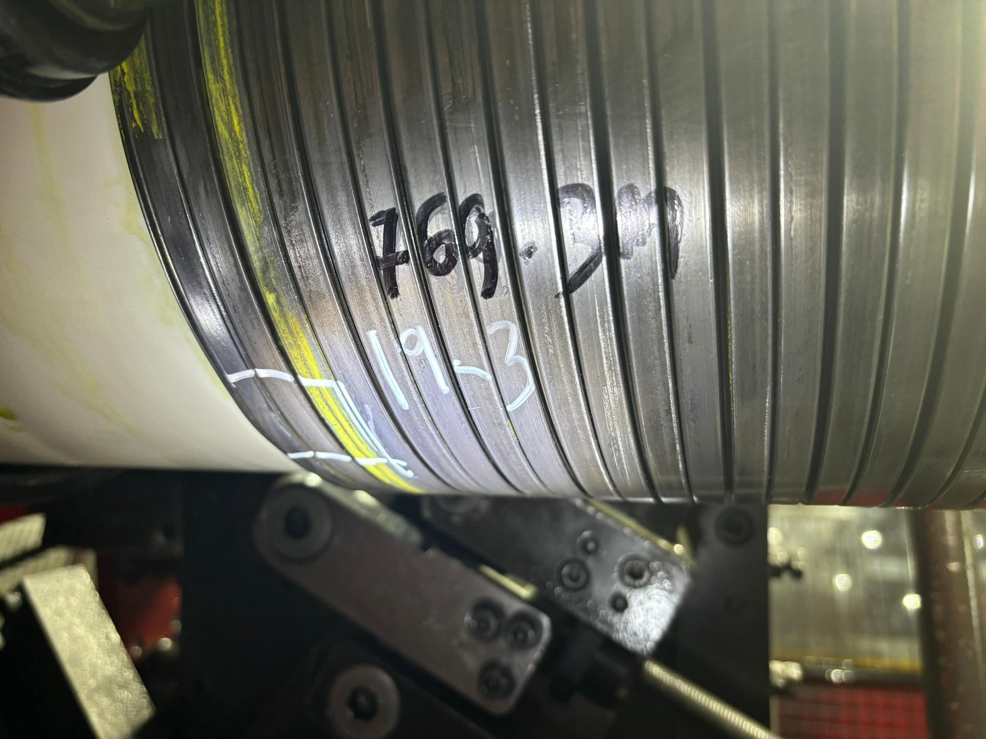
Photo After Repaired
Figure 3 : Production performed un-spiralling, removed affected wires and re-weld before proceeding spiralling process. Dimension after repaired are all within criteria and accepted as per DP-QCP-08DAQT001.

Slide 7

THANK YOU

